Slide 1


Virtual Radio Broadcasting
19CCE281 Signal Processing Lab
Third Semester, December 2021

Slide 2
Group C – Team 4
Serial Number | Name | Roll Number
1 | Santosh | CB.EN.U4CCE20053
2 | V Srihari Moorthy | CB.EN.U4CCE20060
3 | Sudhan Saravanan | CB.EN.U4CCE20061
4 | AR. Vishaline | CB.EN.U4CCE20071

Slide 3

Objectives
To explore various areas under signal processing such as modulation, demodulation, designing of filters, and spectral analysis.
To portray a real-world scenario of a communication or transmission system.
To also emphasize or detect components of interest in a sound signal.
We are informed of various mathematical and computational algorithms to provide for efficient transmission and quality communication.

Slide 4
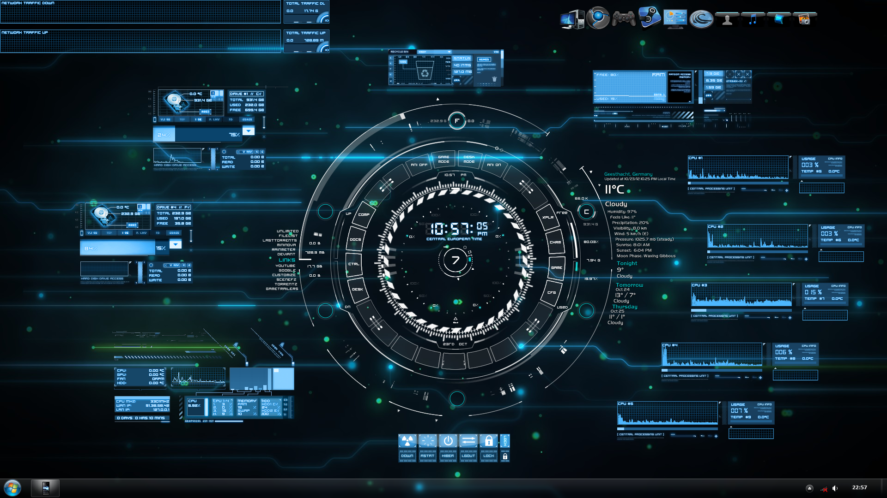
System Description with Application
Modulation – It is the process* of varying one or more properties of a periodic waveform, called the carrier signal, with a separate signal called the modulation signal that typically contains information to be transmitted.
Demodulation – It is extracting the original information-bearing signal from a carrier wave. Modulation and demodulation techniques employ phase angle changes to obtain the desired result.
Filters – They are used to remove some unwanted components or features from a signal. Filtering is a class of signal processing, the defining feature of filters being the complete or partial suppression of some aspect of the signal.

Slide 5
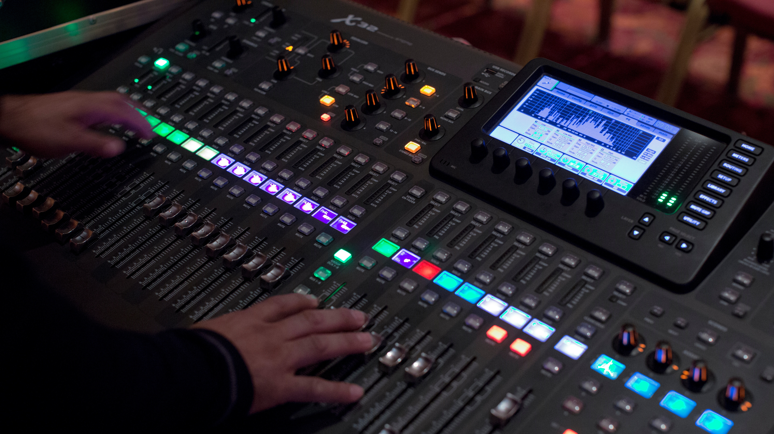
Methodology
User Input
Music (Read a Sound File)
News (Modulation/Demodulation Techniques)
Gossip with RJ (Record Sound)
The Kids Arena (Creation of Soundtracks)
Troubleshoot Errors (Filtering & Denoising)
Signal Generation*
A sound file is read from an external source to either plot its waveform or used for further processing.
A sound file is generated with its defined characteristics to denote the start and the end of our project.
Recording a sound file is done through an external microphone.
Signal Processing*
In this step, sound files are made ready for broadcasting. The sound signal is modulated with a carrier wave for transmission.
After this, the modulated sound signals are transmitted and received at the other end. This received signal is demodulated to extract the sound signal.
This sound signal must be filtered to restore its original form. In our project, removing noise and filtering sound signals are part of the troubleshooting and diagnosing process.

Slide 6
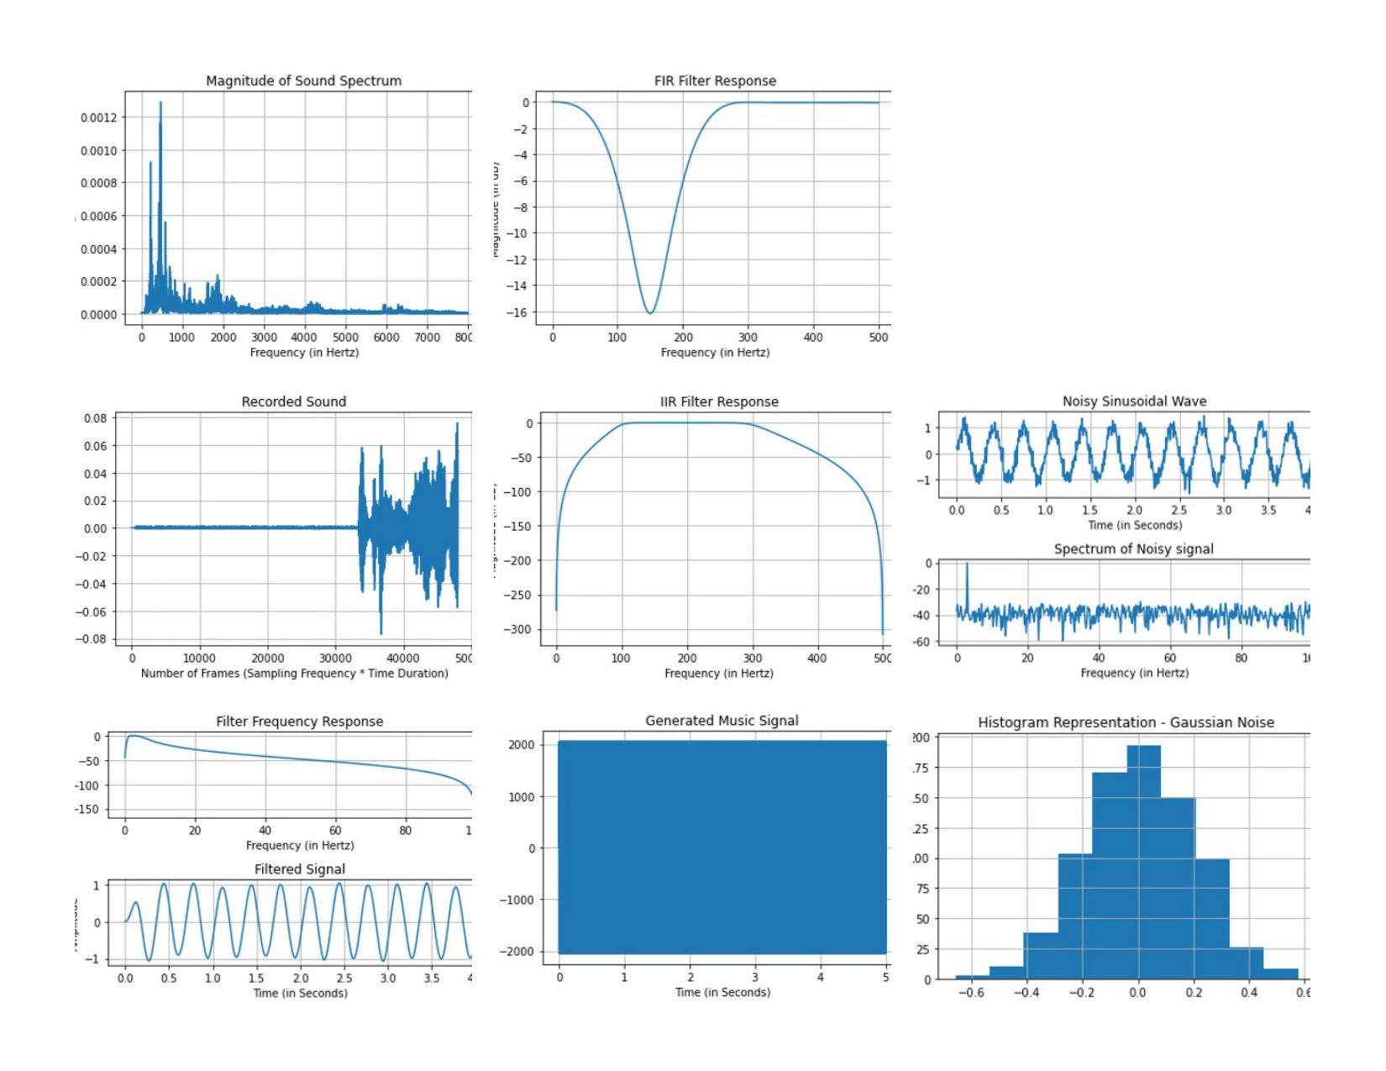
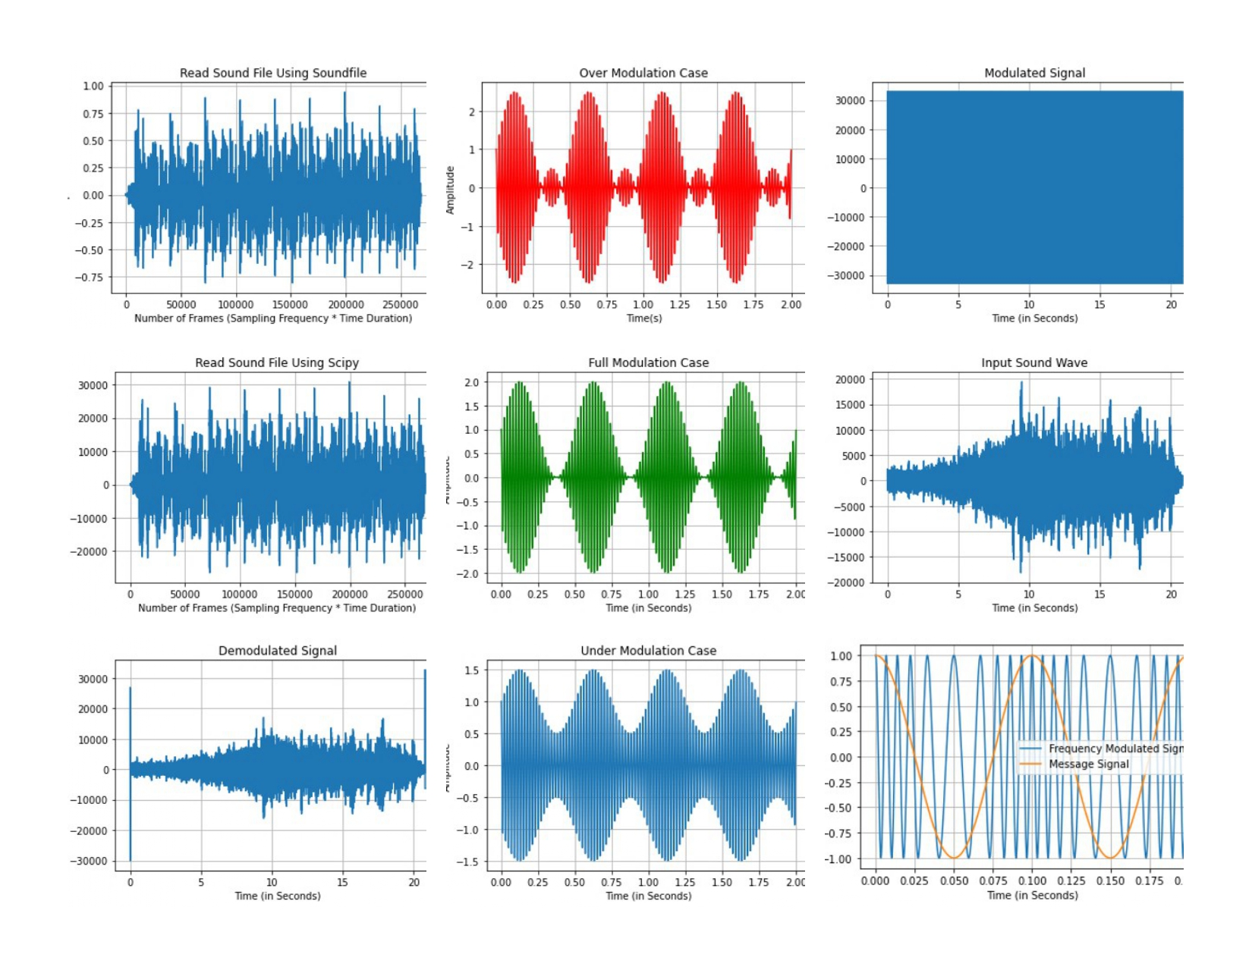
Simulation Results
The corresponding sound file for the entered option from the menu is played. It is also plotted as a waveform.

Slide 7
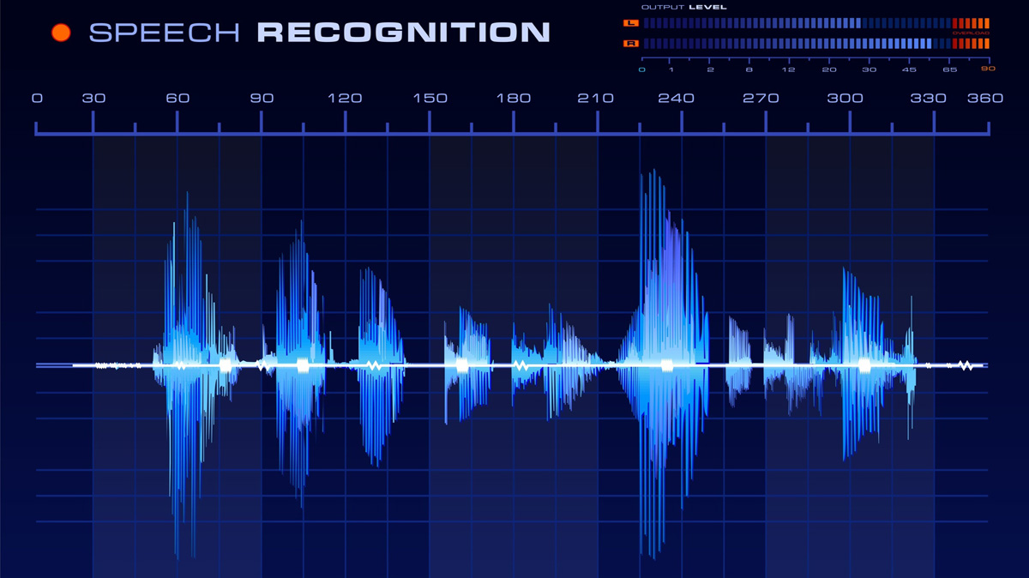
Conclusion and Future Prospects
Audio/sound processing is a special case of signal processing, which is applied to process and analyze speech signals.
Some of the typical applications of speech processing are speech recognition, speech coding, speaker authentication, speech enhancement, detection and removal of noise, speech synthesis, text to speech conversion, etc.
Here, the simulation of broadcasting which involves modulation/demodulation, filtering, is done using programmed sound operations.
Although the advantages of digital signal processing technology are obvious, its shortcomings such as sound quality and signal transmission rate cannot be neglected.
Therefore, it is necessary to continue research on digital signal processing technology, for convenient and reliable communication.

Slide 8
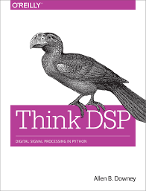
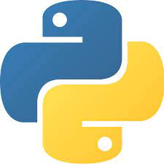
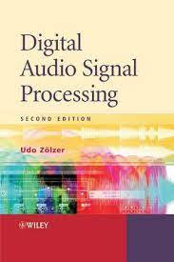

References
Think DSP: Digital Signal Processing in Python, Allen B. Downey, O'Reilly Media, 2016 (ISBN: 9781491938515)
Digital Audio Signal Processing, Udo Zölzer, Wiley, 2008 (ISBN: 9780470680025)
Real-time FM Radio for Teaching DSP and Communication Systems: https://ieeexplore.ieee.org/abstract/document/6684995
Signal Processing in Musical Terms and Music Theory Visualization: https://towardsdatascience.com/music-in-python-2f054deb41f4
How to Perform Frequency Modulation with a Digitized Audio Signal: https://www.allaboutcircuits.com/technical-articles/how-to-perform-frequency-modulation-with-a-digitized-audio-signal/
Virtual Labs: Amrita Laboratories Universalizing Education (https://vlab.amrita.edu/) and Jagadish Chandra Bose Research Organization (https://www.jcbrolabs.org/)
Other Community Sources: Python Documentations, Stack Overflow, Geeks For Geeks, YouTube

